Slide 1
SeisMOS Alarm

Slide 2
Abstract:
Earthquake is a natural phenomenon, which can cause large spread damage due to falling of buildings and after shocks. Seismos Alarm is a way of detecting the earthquake as quickly as possible. The seismos alarm has buzzer which will alarm whenever there is a movement in the ground. The setup of the system is very easy to install and since the component used is very less therefore easy to maintain.

Slide 3
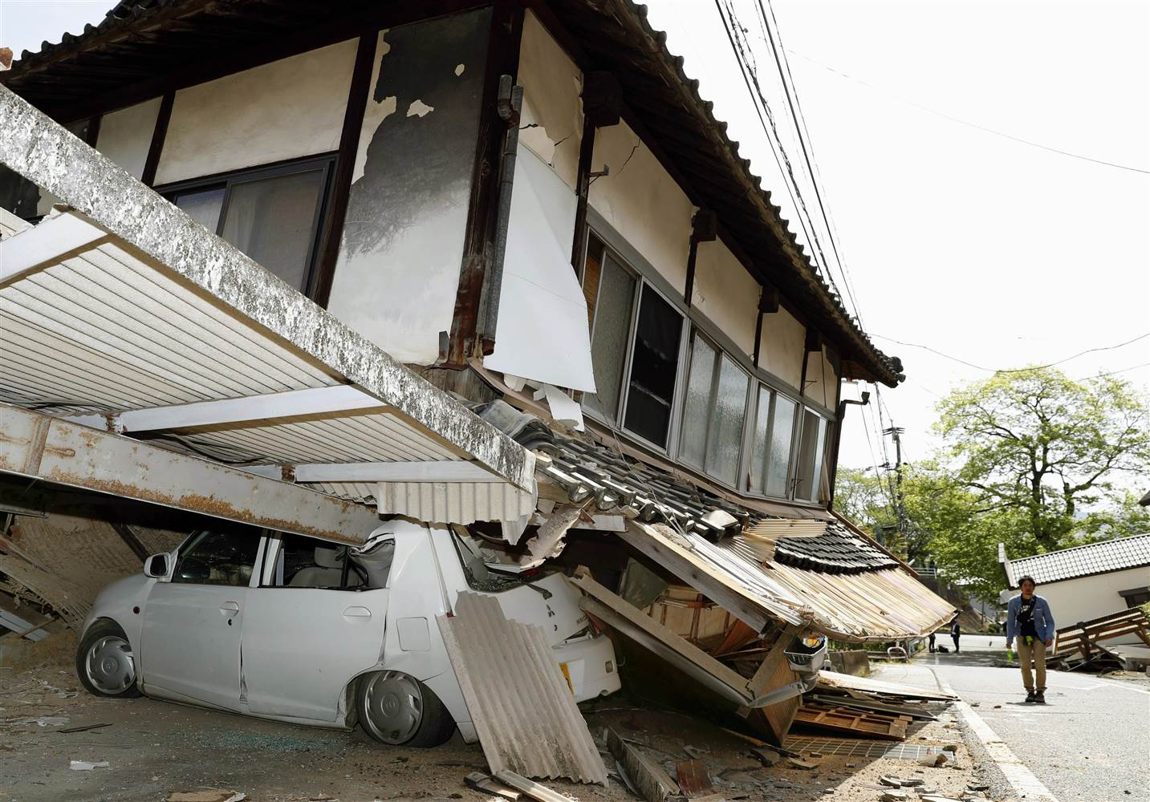
IntroDUCTION
Part 1:
Earthquake is natural phenomenon. We
cannot predict when and where will the
next quake happen. We can only prepare
well for the miss happening that may occur.
There are 2 ways to do that:-
Making the structure very strong
Increasing the response time of the
victims

Slide 4
Part 2:
We are working on increasing the response time of the victims.
We are designing a circuit which will get triggered whenever an earthquake happens.
This helps in making sure that an earthquake has actually happened.
Our project detects even the slightest of the vibration that has occurred in the building.
Arduino acts as the brain of the system, it processes the data, compare the data and make the decision according to the conditions we have given.
MPU6050 reads the acceleration values of the circuit, during the earthquake , acceleration values changes, these changes are detected by the MPU6050.

Slide 5
Comp0nents USED
Arduino Uno
MPU6050
BUZZER
WIRES
Switch Button

Slide 6
What’s the need ?
Key points :-
All the parts of India are divided in 5 Earthquake zones, the level of danger increases with increase in zone number.
Chandigarh lies in Seismic zone 4. Just 1 level less than the highest level.
No one can predict Earthquake, we can only prepare and respond as quickly as possible.
Urgent need to increase the Response time whenever an earthquake occurs.

Slide 7
About The project
Nothing is important than saving the innocent lives, our project exactly do this job.
The Earthquake detector primarily focuses on increasing the response time of the victims of the earthquake prone area.
Earthquake detector removes all types of doubts about whether an earthquake has actually occurred or its just a drowsy feeling or dizziness.
Thus increasing the response time of the victims
The project is compact in size, easy to carry and can therefore fit anywhere.
It requires less components so it’s very easy to maintain.

Slide 8
Working principle
Arduino Uno is used as the brain of the whole set up. Arduino is actually a micro controller.
Arduino is used to keep the data as well as process the data. It works with other peripheral devices to enhance the overall utility.
We have used a sensor, named as MPU6050 which basically gives the change in acceleration in any of the 3 axis, namely X,Y,Z.
We calculate these changes in such a way that if there is even the slightest movement, it will capture that and trigger the buzzer.

Slide 9
Code:-
#define rd 10
int avg(int16_t *arr){
int ret=0;
for(int i=0;i<rd;i++)
ret+=arr[i];
ret/=rd;
return abs(ret);
}

Slide 10
void setup(){
pinMode(5,OUTPUT);
pinMode(6,OUTPUT);
pinMode(7,OUTPUT);
digitalWrite(5,HIGH);
digitalWrite(7,LOW);
Serial.begin(9600);
Wire.begin();
Wire.beginTransmission(MPU_addr);
Wire.write(0x6B); // PWR_MGMT_1 register
Wire.write(0); // set to zero (wakes up the MPU-6050)
Wire.endTransmission(true);
}

Slide 11
void loop(){
Wire.beginTransmission(MPU_addr);
Wire.write(0x3B); // starting with register 0x3B (ACCEL_XOUT_H)
Wire.endTransmission(false);
Wire.requestFrom(MPU_addr,6,true); // request a total of 14 registers
AcX[index]=Wire.read()<<8|Wire.read(); // 0x3B (ACCEL_XOUT_H) & 0x3C (ACCEL_XOUT_L)
AcY[index]=Wire.read()<<8|Wire.read();
AcZ[index]=Wire.read()<<8|Wire.read();
AcX[index]/=100;
AcY[index]/=100;
AcZ[index]/=100;

Slide 12
devX=abs(avg(AcX)-AcX[index]);
devY=abs(avg(AcY)-AcY[index]);
devZ=abs(avg(AcZ)-AcZ[index]);
index++;
index%=rd;
dev=sqrt(devX*devX+devY*devY+devZ*devZ);
if(dev>6)
buzzerDelay=1000;
if(buzzerDelay){
digitalWrite(6,LOW);
buzzerDelay--;
}
else
digitalWrite(6,HIGH);
Serial.println(dev);
delay(10);
}

Slide 13
ABOUT US
PROJECT MADE BY :- Abhijeet (CO17302) AND Ashish (CO17314)
PROJECT SUBMITTED TO :- Dr. Sunil.K.Singh
SUBJECT :- MICROPROCESSOR
PROJECT TITLE :- Earthquake Detector

